Slide 1

CSC 2302/DSCI 1302 Sorting Algorithms

Slide 2
Comparison Sorting Visualization (usfca.edu)

Slide 3
Selection Sort
This sorting technique repeatedly finds/selects the minimum element and sort it in order
Start working from the first index
find the minimum
Swap if needed
min

Slide 4
Selection Sort: example
12
7
3
11
23
12
7
23
11
3
12
11
23
7
3
12
23
11
7
3
23
12
11
7
3
Current index
Minimum index

Slide 5
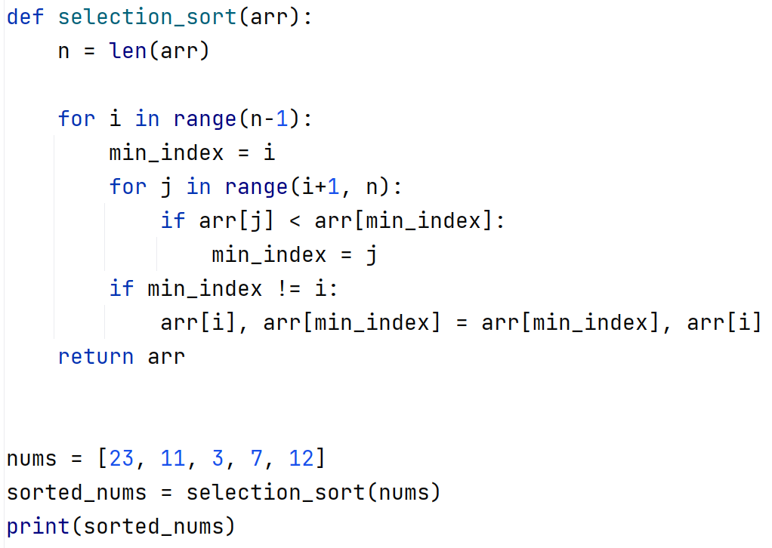
Selection sort: python implementation
O(n²)

Slide 6
Sorting Exercise – Selection Sort
11
12
1
9
6
5
4
7
Current index
Minimum index

Slide 7
Selection Sort – Descending Order?

Slide 8

Insertion Sort
treats the input as two parts, sorted and unsorted
repeatedly inserts the next value from the unsorted part into the correct location in the sorted part
8
7
9
4
5
8
K
A
Sorted
Unsorted

Slide 9
11
12
1
9
6
5
4
7
Sorted
Unsorted
11
12
1
9
6
5
4
7
Sorted
Unsorted
1
11
12
9
6
5
4
7
Sorted
Unsorted

Slide 10
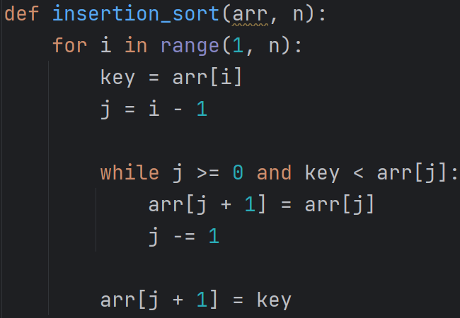

Slide 11
Sorting Exercise – Insertion Sort
11
12
1
9
6
5
4
7
Key = 12

Slide 12
Insertion Sort – Descending Order?

Slide 13
Reading Assignments from Zybook
16.5 Sorting: Introduction
16.6 Selection sort
16.7 Insertion sort

Slide 14
Sorting: Divide-and-conquer strategy
Breaks down a problem into smaller and more manageable subproblems
Sub-problems are solved independently
Solution of the subproblems >> solution to the original problem
Problem
Divide
Sub-problem1
Sub-problem2
Sub-problem3
Conquer
Solution

Slide 15
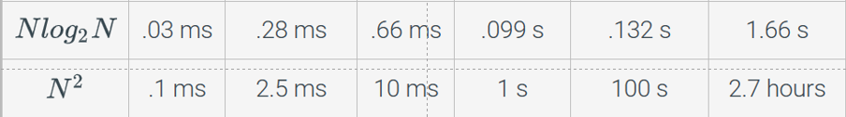
Divide-and-conquer based sorting:
Quicksort
Mergesort
Sorting Algorithm | Average-case time complexity
Bubble sort | O(n²)
Selection sort | O(n²)
Insertion sort | O(n²)
Quick sort | O(nlogn)
Merge sort | O(nlogn)

Slide 16
Why do we need to learn the Bubble, Selection, and
Insertion sort algorithms then if they are slow?
learning the basic principles of sorting
Understanding the fundamental concepts like comparison-based sorting, swapping, and iterating through arrays or lists
develop your critical thinking and problem-solving ability
building blocks for more advanced sorting algorithms, e.g., merge sort and quicksort

Slide 17
Merge Sort
Merge Sort is a Divide and Conquer algorithm.
It divides input array in two halves and sorts them
Finally, it merges the two sorted halves

Slide 18
Example: Merge Sort
5
2
4
7
1
3
2
6
Divide
Process
5
2
4
7
1
3
2
6
5
2
4
7
1
3
2
6
5
2
4
7
1
3
2
6

Slide 19
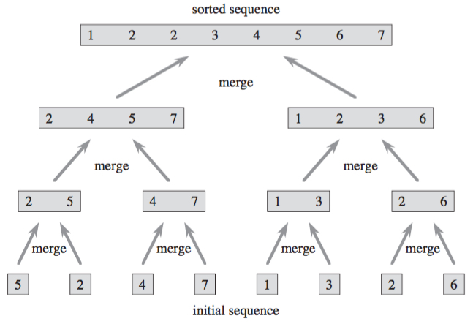
Example: Merge Sort
Combine
Process

Slide 20
Merge demonstration
Goal: Merge left and right half in proper order
i
left
3 | 5 | 6 | 6 | 9 | 33
j
right
1 | 2 | 6 | 7
k
merged
1
2
3
5
6
6
6
7
9
33

Slide 21
Attendance

